Slide 1
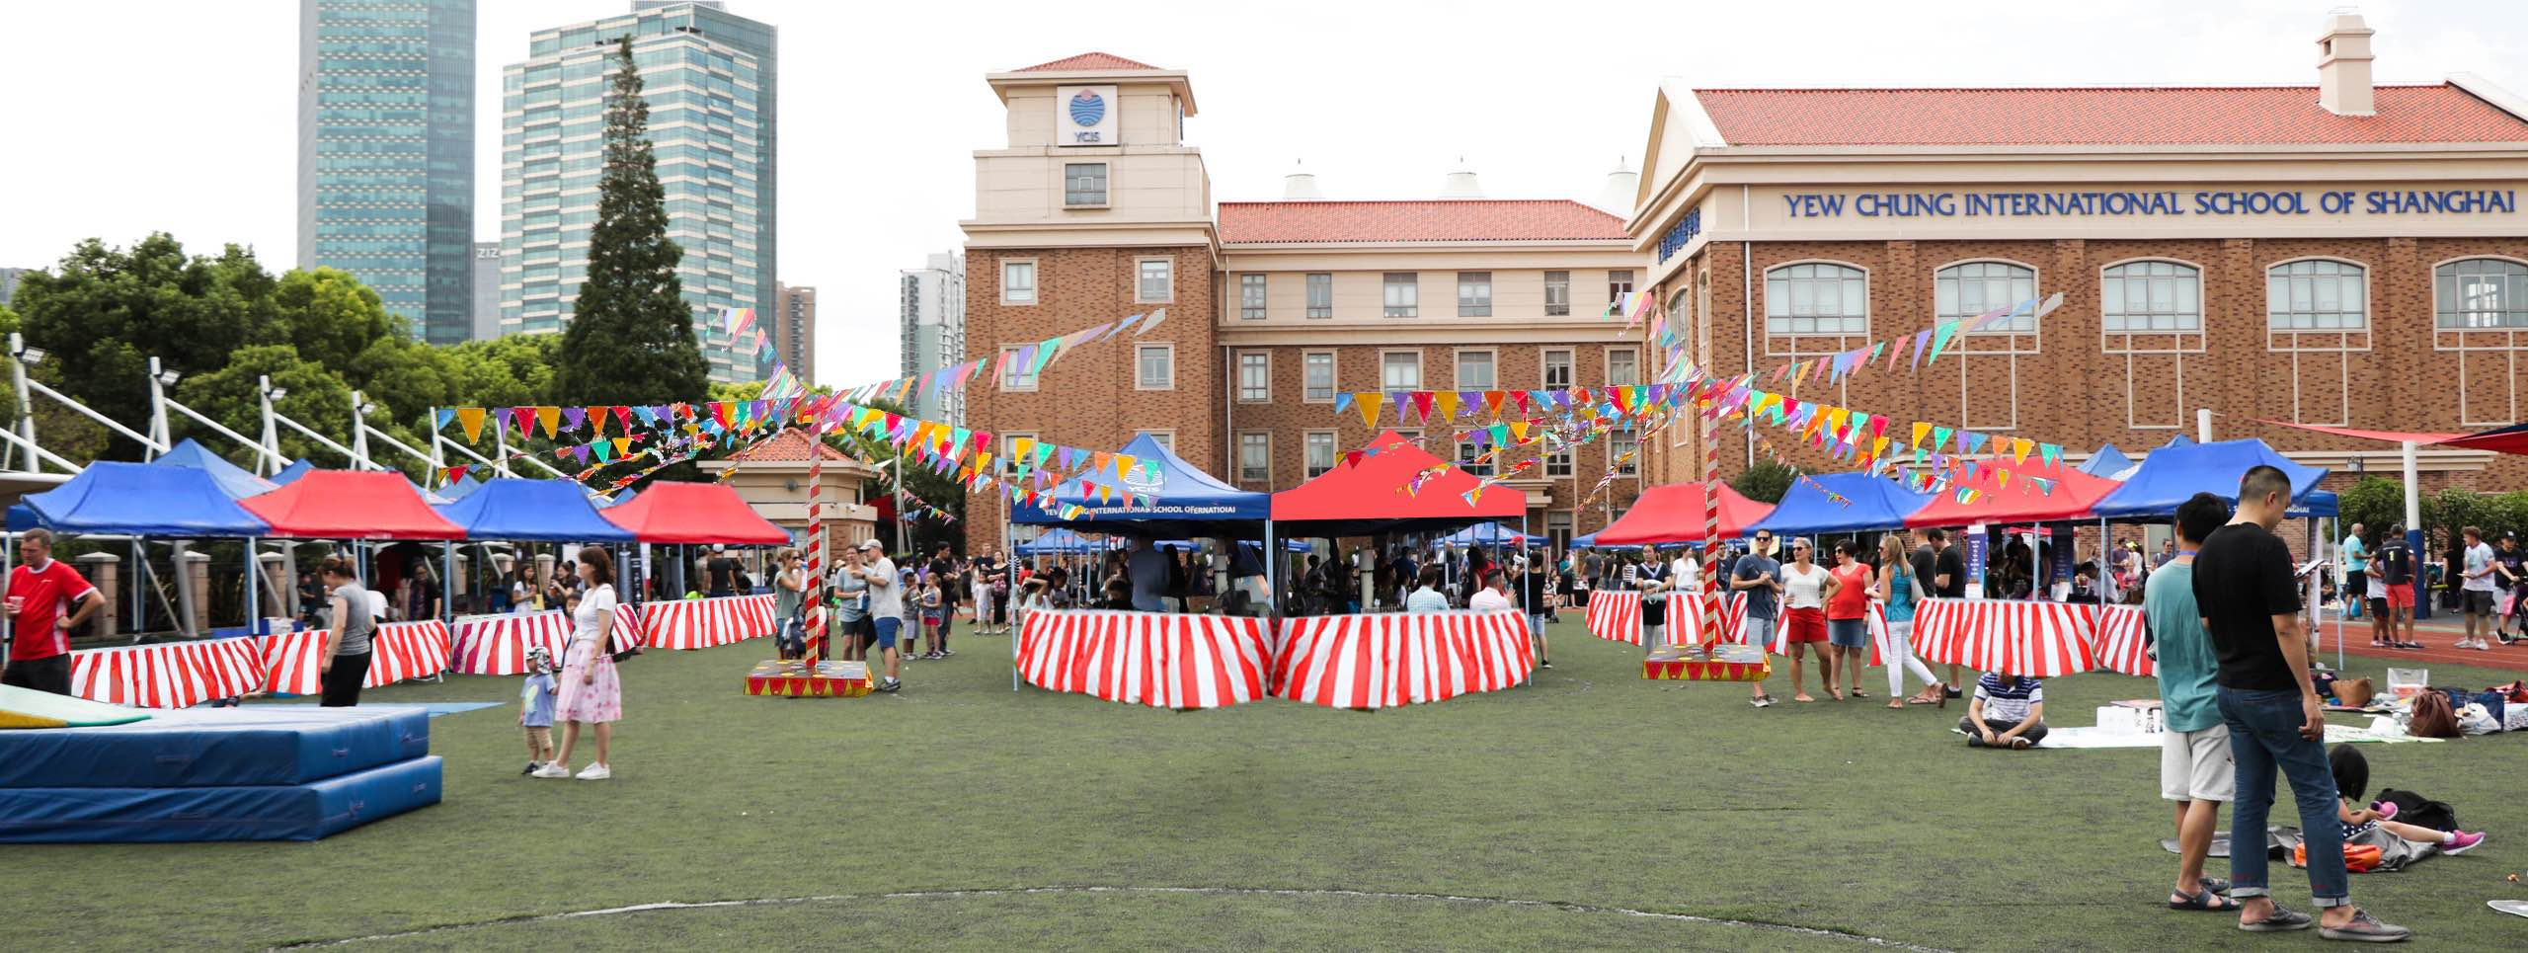

Slide 2
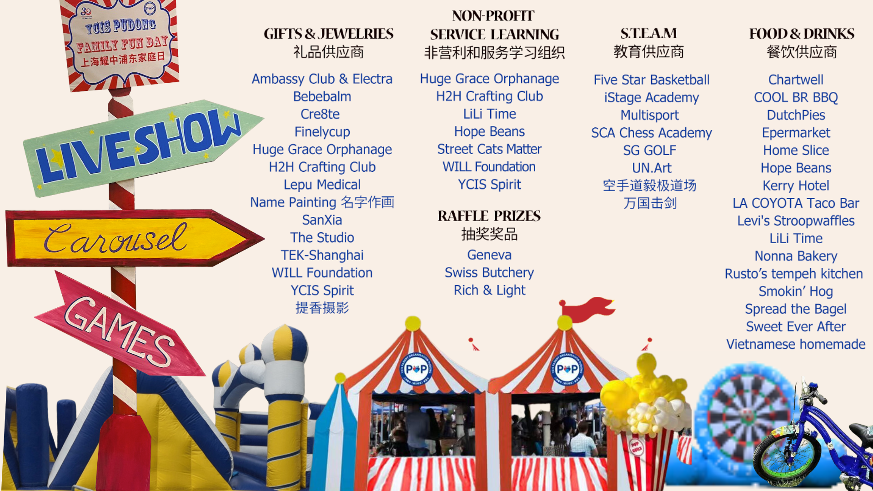

Slide 3
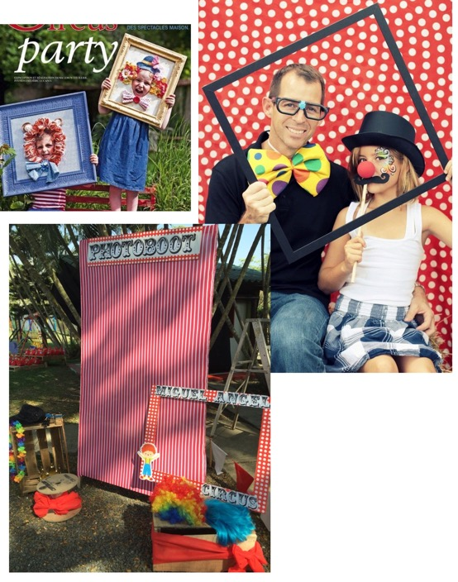
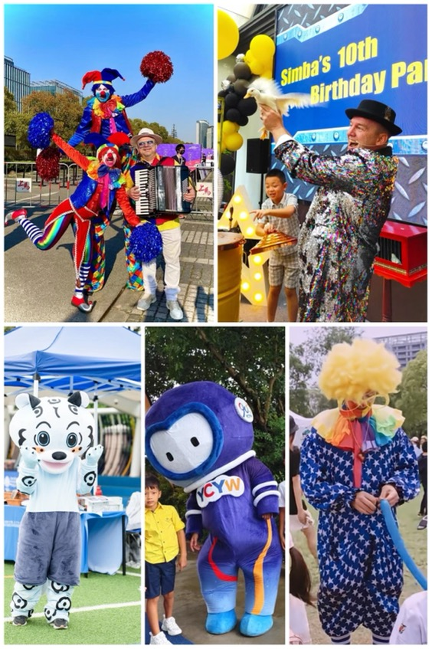
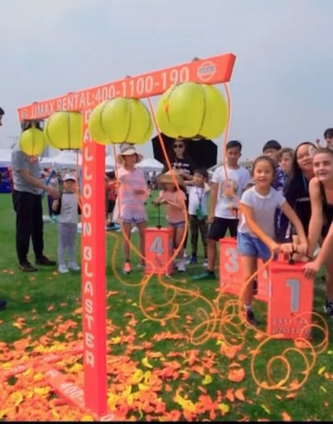
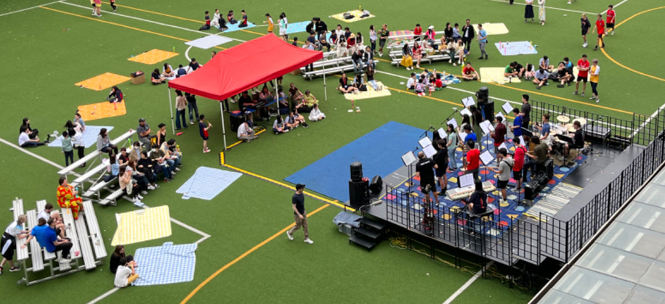
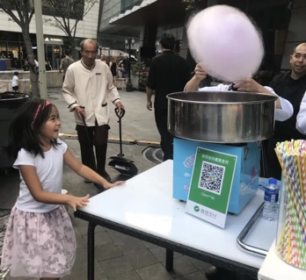
t
Activities
Balloon blasters
Basketball
Bubbles
Bouncy Castles
Carousel
Chess
Crafts
Cycling Track
Football Dart
Fencing
Fishing Pool
Face Painting
Golf
YCIS Storybus
Raffle Prizes
LOADS of incredible PRIZES from
vendors & sponsors!
Live Show
Magicians
Student Performances
Music ensembles
Percussion
Rock Bands
Cultural Dances
Clowns
Chinese Martial Arts?

Slide 4
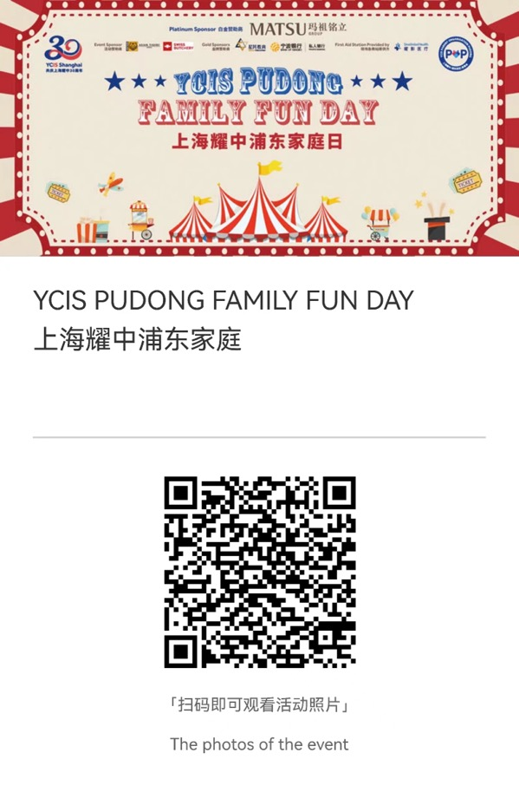
Poster Registration
Live Stream Photos

