Slide 1
SPANISH FOOD PROMOTION
by Chartwells Chef – Juan M. Casado
Starter (soup)
“Vegetables cream soup”
(Potato, carrot, zucchini, leek, cream)
Main course 1 (meat)
“Meat balls with vegetables”
(Pork & beef balls, onion, pepper, tomato, carrot, green peas)
Main course 2 (seafood & meat)
“Spanish rice”
(Rice, chicken, squid, shrimp, peppers, green beans, tomatoes,
chicken stock and lemon)
Dessert
“Quesada”
(Traditional Spanish cheese cake)

Slide 2
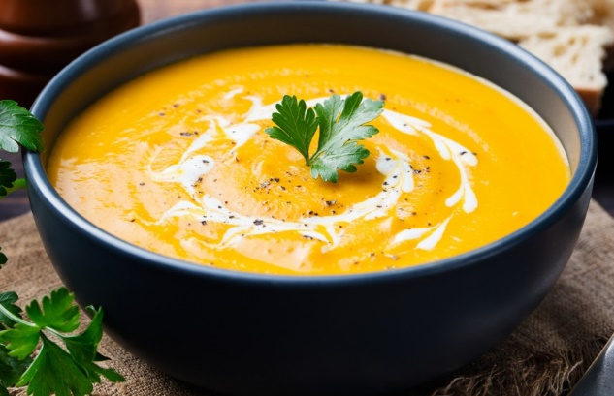
“Vegetables cream soup”
(Potato, pumpkin, zucchini, leek, cream)

Slide 3
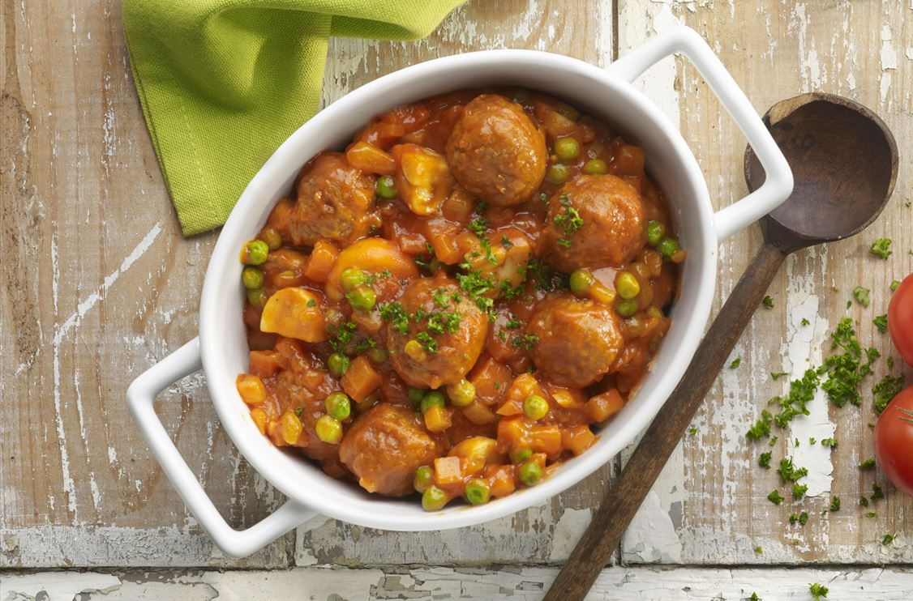
“Meat balls with vegetables”
(Pork & beef balls, onion, pepper, tomato, carrot, green peas)

Slide 4
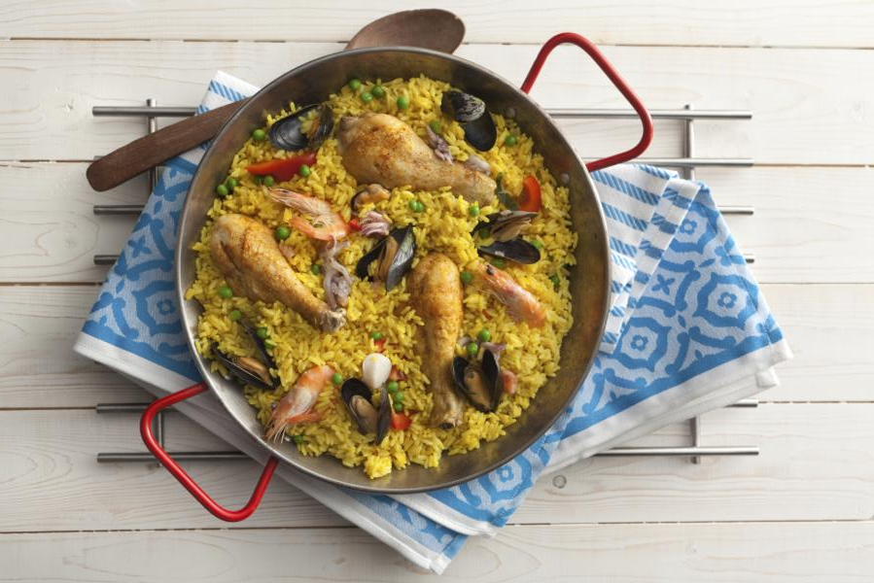
“Spanish rice”
(Rice, chicken, squid, shrimp, peppers, green beans, tomatoes, chicken stock and lemon)

Slide 5
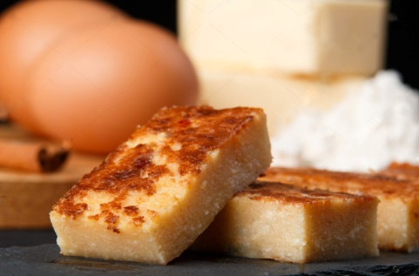
“Quesada”
(Traditional Spanish cheese cake)

