Slide 1
Kids’ Night In

Slide 2
Key Details
Y1-5 at RP (3.30-6.30) and Y6 at CP (3:30-6:45)
Letter to go out Friday 3rd May
Money (100 rmb) due in Tuesday 14th May
There are no RP CCAs on KNI day and at CP students can attend after their CCA
This is a free dress day for all students (not just those taking part in KNI).
Named activity leaders will receive a separate email with details of their role. Let me know if anything is unclear.
The craft activity this year will involve making moon bear costumes, students can take photos in the disco with their costumes on.
Zoe and Andrea will lead the event, please direct any questions to them.

Slide 3
RP and CP Campuses
Co-teachers should accompany their class to all activities and be responsible for general assistance and supervision.
Each class will receive an assigned classroom for activities (CP to decide)
It is the teachers’ responsibility to take the group at the end of the session to their next activity.
Teachers should ensure that all the students leave the activity at the correct time and go to the next activity.

Slide 4
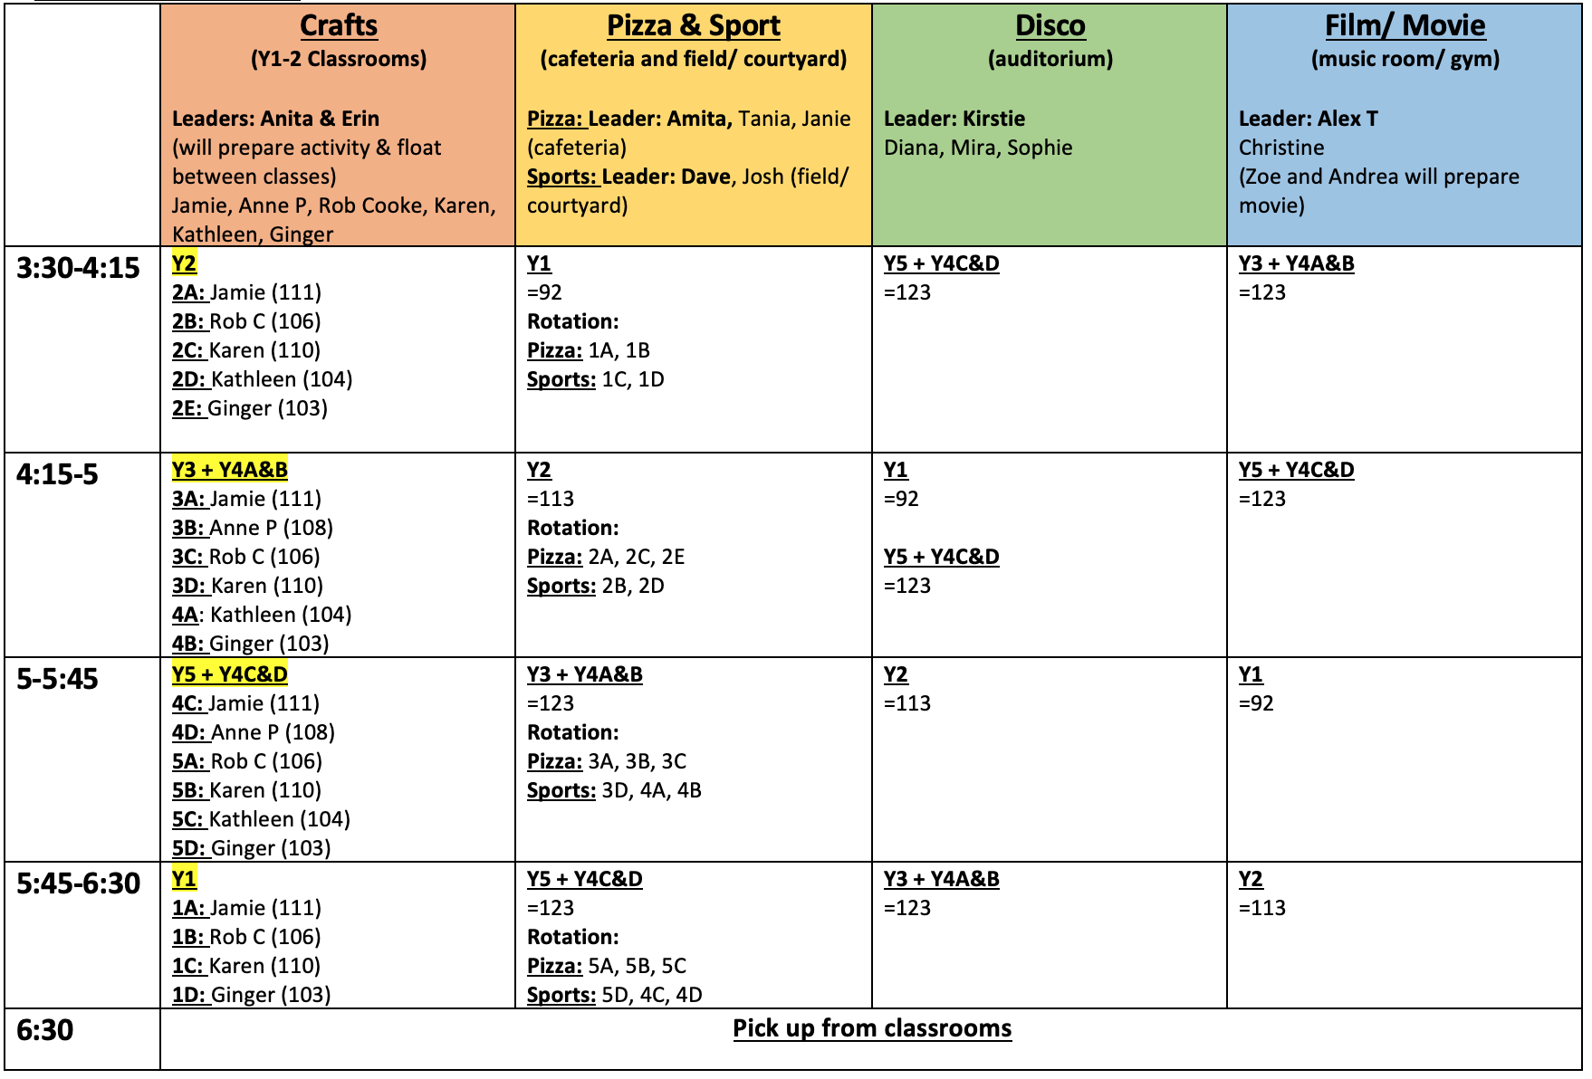
RP Campus: Y1-5 Students

Slide 5
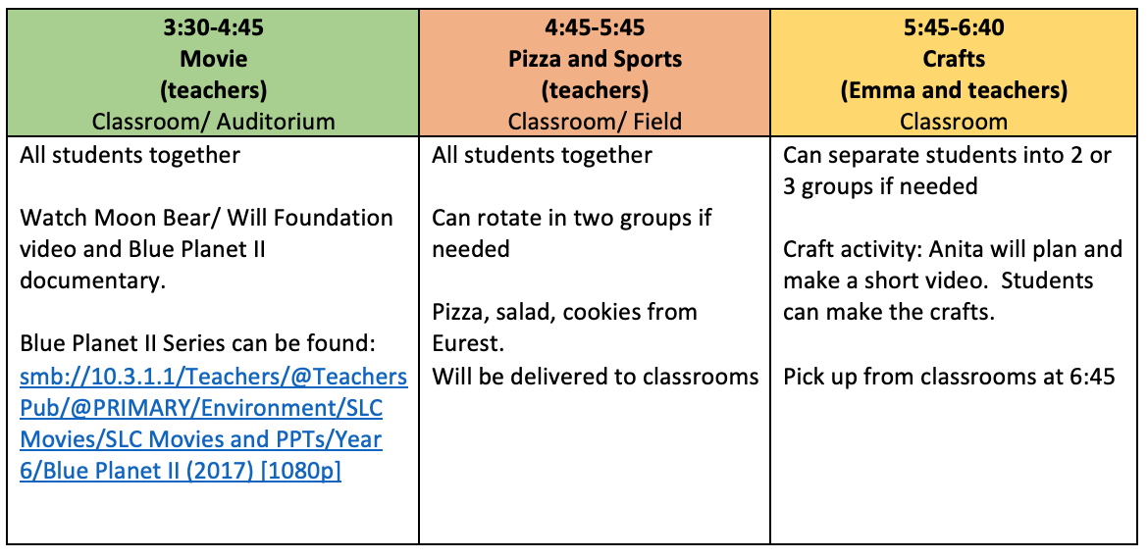
CP Campus: Y6 Students

Slide 6
Food
Pizza, salad and cookies will be provided by Chartwells.
Drinks- Please encourage children to fill their water bottles from the water stations as normal. Students will be reminded to bring a plastic refillable bottle.
There will be a vegetarian option available.
Pick Up
From classrooms at 6.30pm for RP and 6:45 for CP

