Slide 1
MacOS Sierra Upgrade Guide

Slide 2
Preparation for upgrade
Before you upgrade your laptop, please make sure your data have been backed up by using the Time Machine app.
Restart your computer before you upgrade your laptop.

Slide 3
Cache the upgrade package through Self Service

Slide 4
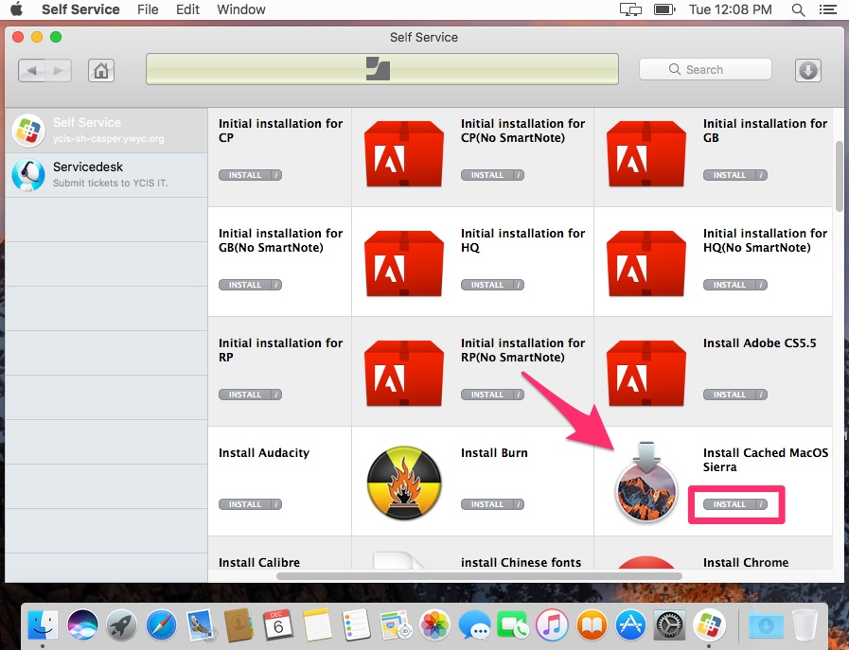
Install the cached installation package

Slide 5
Please find the IT technician for assistant if you get any problems. Thanks you!

