Slide 1
English as an Additional Language
(EAL)
at
YCIS Shanghai Primary
Regency Park & Century Park

Slide 2
YCIS Language Policy
Rationale-
“YCIS recognizes that learners must be proficient in the academic language of instruction if they are to have successful access to the curriculum.”
Operational Guidelines
“All YCIS subject teachers shall also be considered as ‘language teachers’.”

Slide 3
EAL at YCIS Shanghai Regency Park/Century Park
5 EAL teachers teaching in Years 1-5
Ginger Hsieh, Kathleen Wu, Robert Cooke, Joshua Williams & Karen Franklin
1 EAL/LR teacher teaching in Year 6
Colin Gallagher
Additional instructors
Coordinator John McEnhill
Coordinator Melissa Shaw
Coordinator Andrea Griego

Slide 4
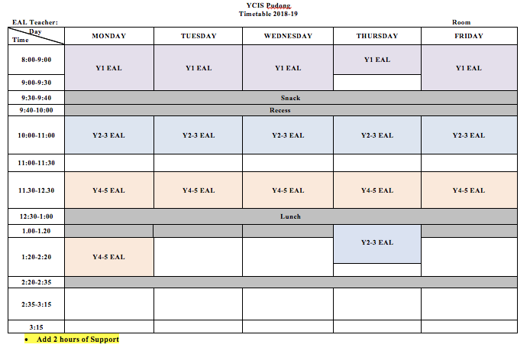
EAL at YCIS Pudong Primary
Students in the Y1-Y5 EAL programme attend EAL classes during the scheduled English period six times during the week: 5 times in the morning and once in the afternoon. Exception being Y1 which have a longer literacy period.

Slide 5
EAL Support
There is additional in-class or pullout support to meet the needs of students. The times and days of in-class or pullout support will be scheduled by the assigned EAL teacher and the year level teachers. Most support times will be between 15 and 30 minutes; however, this may differ for Y6.
Please keep in mind that EAL teachers also have a full schedule and we will do our best to support students with the times allotted in our schedule.
Starting in September, EAL teachers will be providing support for K4 students to help early language acquisition.

Slide 6
EAL Support Continued
EAL teachers will offer classroom teachers a menu of EAL support strategies that will make the most of support time when they are providing in-class support.
Students who exited EAL at the end of the year will be given EAL support for up to three months if needed. EAL has identified these students and will decide with the classroom teacher if this support is appropriate.

Slide 7
Variables to remember when teaching EAL students:
Age
Personality
Previous language learning experiences
Exposure to the language at home
Learning styles - visual, kinesthetic, aural
Culture
First language

Slide 8
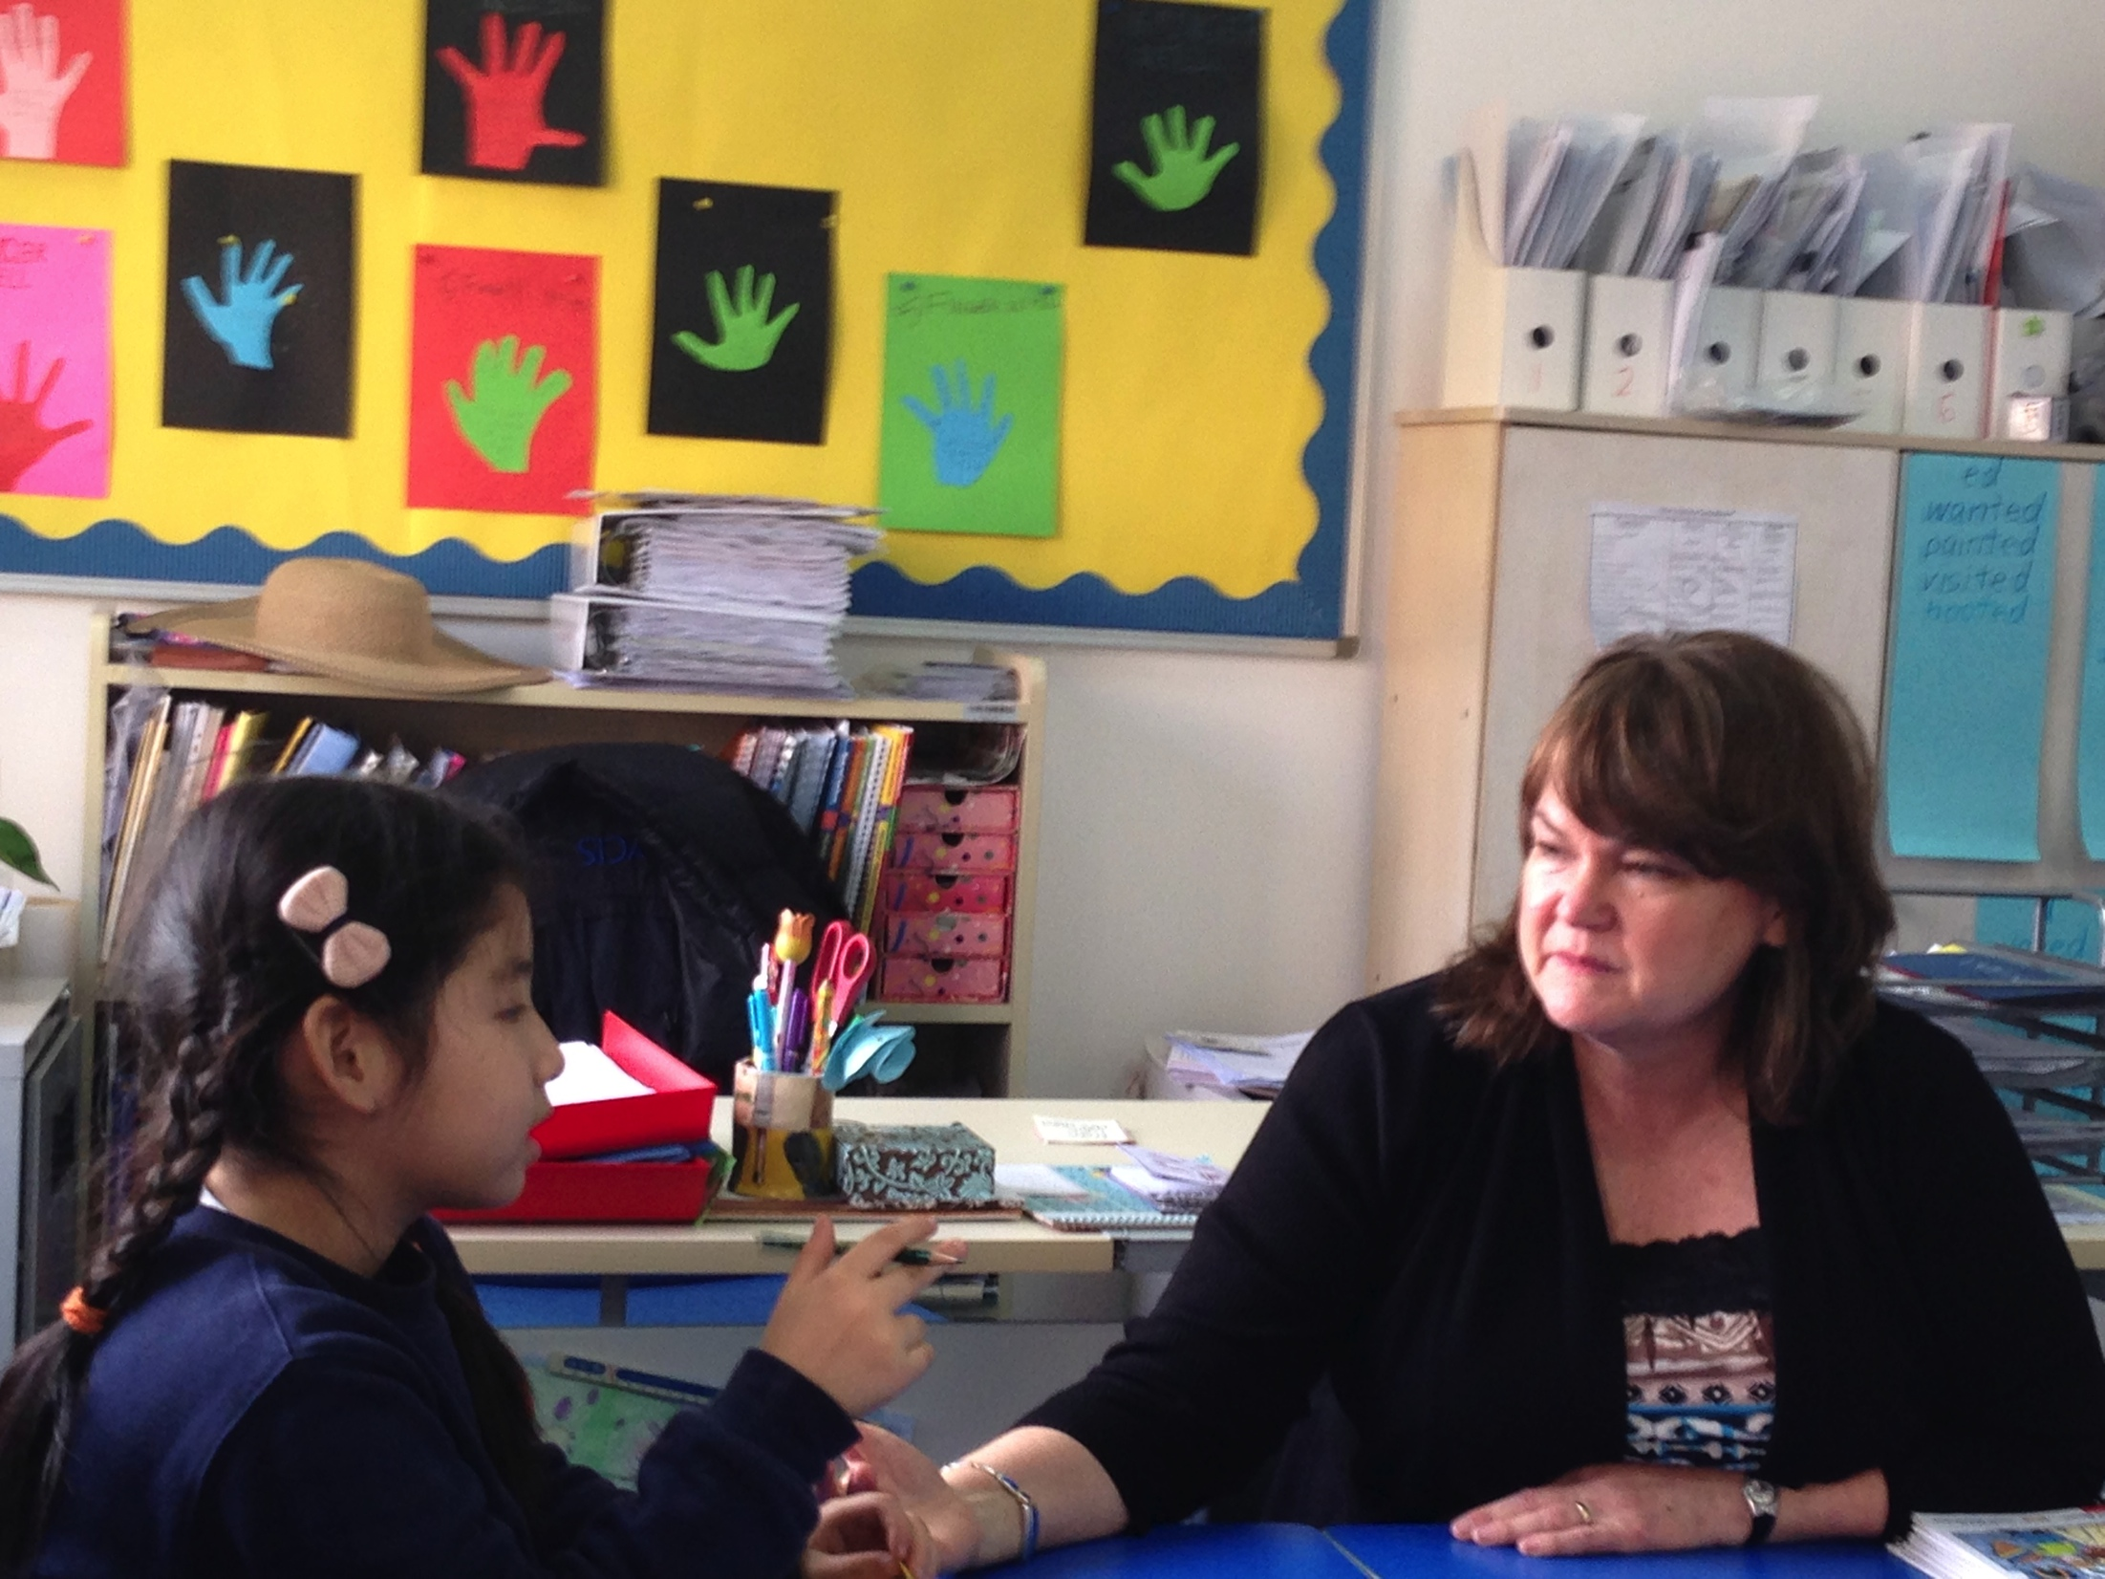
Variation in Language Development Patterns
A silent period for early language learners
Concept of a critical mass of language
Plateaus in learning are to be expected.

Slide 9
EAL Procedures
During the first weeks of school, students will be tested on their English language abilities in the areas of: Speaking, Listening, Reading and Writing.
EAL Level III students will take the English SAT test. Level I and II EAL students will not take the English SAT. All EAL students will take the, MAC II Language assessment, PM Benchmark reading assessment and the HFW assessment.

Slide 10
EAL Procedures continued
New students enroll throughout the year, and because some of these students only arrive in Shanghai a few days before they begin school, an EAL assessment may need to be given within the first two days of the student’s start date to determine the student’s English language abilities.
This often means that new students will remain in the mainstream classroom until they have been assessed and the correct EAL placement is found. Teachers can use this time to get the student acquainted to the classroom, students and procedures. In some cases, EAL can provide work for students, but often students with no English language are unable to complete this work. This is a good time for the student to observe and become familiar with their new surroundings and classmates.

Slide 11
Mainstreaming
When an EAL student is ready for Mainstream, the EAL teacher will communicate with the classroom teacher.
Questions can include: What are the PM levels of your current students? What activities are being done in the current unit and when will the unit conclude? Can we review some writing samples of your students’ recent work?
Teachers will work together to make sure that movement is at a good time. This will usually be when a new unit is beginning.
Teachers will also discuss common goals and strategies to best help the student acclimate into the mainstream classroom. Communication and cooperation is key!

Slide 12
Mainstreaming Continued
When a student is Mainstreamed, an English proficiency test (MACII Form B) will be completed with the student, a movement form will be completed, and the movement form with the results will be passed to the classroom teacher and the Student Support and Wellness Coordinator.
An EAL Mainstream letter completed by the EAL teacher will be used to inform parents of their child’s advancement to Mainstream. Parents will be invited to attend an assembly in which their child will receive an award for advancing to Mainstream English.
When moving students to Mainstream for the following school year in May or after the last unit has begun, students will remain in their EAL classroom until the end of the year.

Slide 13
Mainstreamed
Once a student is mainstreamed they may need support and extra attention as they adjust to the mainstream literacy classroom. The EAL teacher and the classroom teacher will work together to determine if this support is appropriate.
Notes:
Should I say anything about reports? Who takes responsibility?

Slide 14
EAL True or False:
EAL teachers often provide coverage in emergency absences or situations. True
EAL teachers teach a modified version of our English curriculum. True
EAL teachers have a teaching partner. False
There are 10 EAL teachers in Primary. False
EAL teachers have a full schedule. True
EAL teachers love to hear success stories about their EAL students. True

Slide 15
ESL Course for all Teachers
New staff and staff that have not taken these courses:
They will be offered in Semester 2
Melissa Shaw and Kathleen Wu will facilitate the ECE and Years 1 and 2 course: Teaching in a Multilingual Context
Andrea Griego and Jamie Hoel will facilitate the Upper Primary course (Y3-6) : Teaching ESL students in Mainstream Classrooms
This is a Foundation initiative and all YCIS schools are making this a priority.

Slide 16
We are here to help….
Remember that if you have any questions or concerns regarding one of your EAL students, please email or set up a time to meet with their EAL teacher.
Please let us know if you believe your EAL student is ready for Mainstream.
Any questions about our programme? Please contact Kathleen Wu by email or come see me.
Thank you YCIS teachers!!!!!

